Slide 1
LONG SHORT TERM MEMORY
LSTM
Enas Khwaileh and Marwa Al-Harbi
Advanced Artificial Intelligence
Supervised by
Dr. Qanitah Bani-baker

Slide 2
Content
Back to RNN
RNN issues
LSTM History
Basic LSTM
LSTM Cells
Step by Step walkthrough
GatesMathematics LSTM
LSTM Tips and Tricks

Slide 3
What’s the problem?

Slide 4
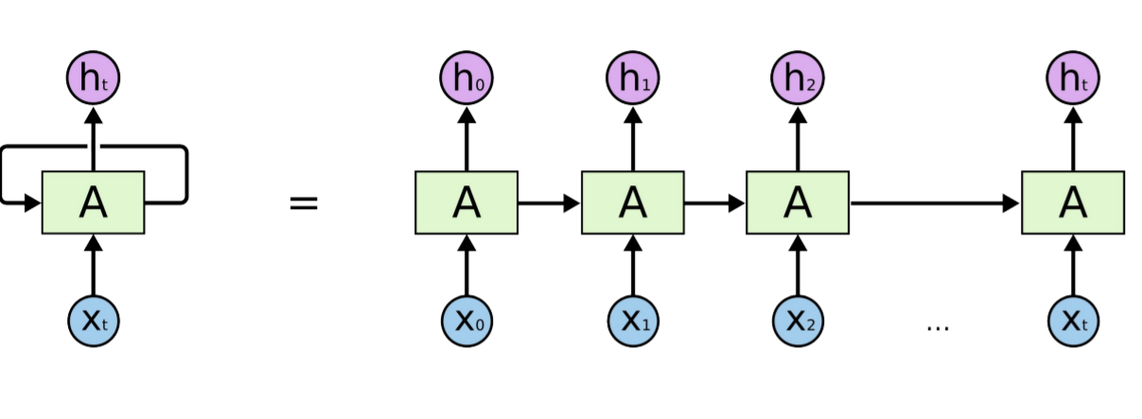
An unrolled recurrent neural network
In the above diagram, a chunk of neural network, A, looks at some input xt and outputs a value ht . A loop allows information to be passed from one step of the network to the next.
Marwa
Notes:
multiple copies of the same network
Humans don’t start their thinking from scratch every second. As you read this essay, you understand each word based on your understanding of previous words. You don’t throw everything away and start thinking from scratch again. Your thoughts have persistence.

Slide 5
RNN & LSTM
There have been incredible success applying RNNs to a variety of problems: speech recognition, language modeling, translation, image captioning… The list goes on.
I’ll leave discussion of the amazing feats one can achieve with RNNs to Andrej Karpathy’s excellent blog post, The Unreasonable Effectiveness of Recurrent Neural Networks. But they really are pretty amazing.
Essential to these successes is the use of “LSTMs,” a very special kind of recurrent neural network which works, for many tasks, much much better than the standard version.
Almost all exciting results based on recurrent neural networks are achieved with them.
Marwa
Notes:
It’s these LSTMs that this essay will explore.

Slide 6
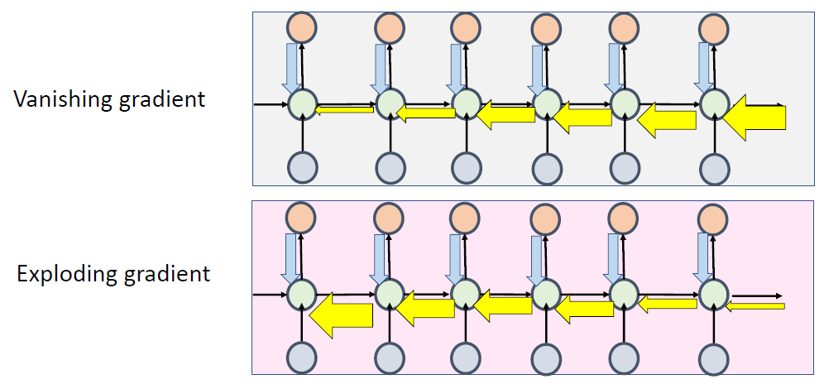
TWO ISSUES OF STANDARD RNN’S
Exploding Gradients
when the algorithm assigns a stupidly high importance to the weights, without much reason. But fortunately, this problem can be easily solved if you truncate or squash the gradients
from Dr.Rasha Obeidat slides
Marwa
Notes:
During back propagation, recurrent neural networks suffer from below problems:

Slide 7
TWO ISSUES OF STANDARD RNN’S
Vanishing Gradients
We speak of “Vanishing Gradients“ when the values of a gradient are too small and the model stops learning or takes way too long because of that. This was a major problem in the 1990s and much harder to solve than the exploding gradients. Fortunately, it was solved through the concept of LSTM.
from Dr.Rasha Obeidat slides
Marwa

Slide 8
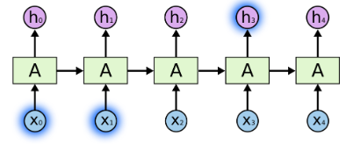
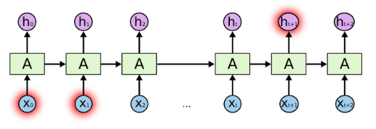
The Problem of Long-Term Dependencies
One of the appeals of RNNs is the idea that they might be able to connect previous information to the present task, such as using previous video frames might inform the understanding of the present frame.
If RNNs could do this, they’d be extremely useful. But can they? It depends.
“the clouds are in the sky,”
“I grew up in France…….. I speak fluent French.”
Because of vanishing gradient RNN is not very good at capturing the long term dependencies
Notes:
Sometimes, we only need to look at recent information to perform the present task. For example, consider a language model trying to predict the next word based on the previous ones. If we are trying to predict the last word in “the clouds are in the sky,” we don’t need any further context – it’s pretty obvious the next word is going to be sky. In such cases, where the gap between the relevant information and the place that it’s needed is small, RNNs can learn to use the past information.

Slide 9
LSTM History

Slide 10
LSTM
Long Short Term Memory networks – usually just called “LSTMs” – are a special kind of RNN, capable of learning long-term dependencies.
The Long Short-Term Memory (LSTM) cell was proposed in 1997 by Sepp Hochreiter and Jürgen Schmidhuber, and it was gradually improved over the years by several researchers, such as Alex Graves, Haşim Sak, Wojciech Zaremba, and many more.
LSTMs are explicitly designed to avoid the long-term dependency problem. Remembering information for long periods of time is practically their default behavior, not something they struggle to learn!
Long Short-Term Memory (LSTM) can solve numerous tasks not solvable by previous learning algorithms for recurrent neural networks (RNNs).
eNAS

Slide 11
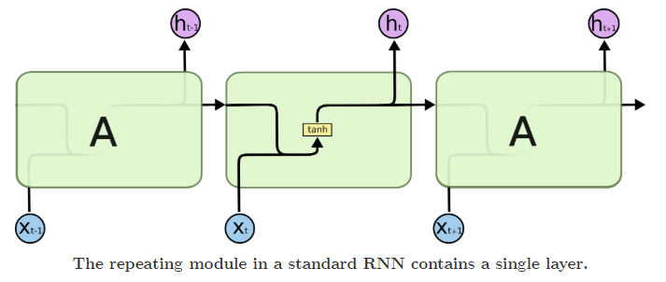
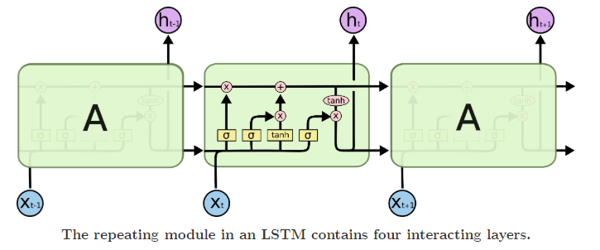
eNAS
Notes:
All recurrent neural networks have the form of a chain of repeating modules of neural network. In standard RNNs, this repeating module will have a very simple structure, such as a single tanh layer.
LSTMs also have this chain like structure, but the repeating module has a different structure. Instead of having a single neural network layer, there are four, interacting in a very special way.

Slide 12

TACKLING THE SHORT-TERM MEMORY PROBLEM
Due to the transformations that the data goes through when traversing an RNN, some information is lost at each time step.
Imagine Dory the fish trying to translate a long sentence; by the time she’s finished reading it, she has no clue how it started.
To tackle this problem, various types of cells with long-term memory have been introduced. They have proven so successful that the basic cells are not used much anymore.
LSTM cell
eNAS

Slide 13
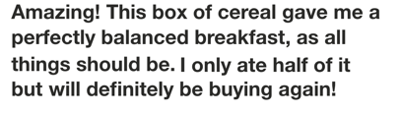

IF YOU HAVE THIS TEXT AND SOMEONE ASK YOU ABOUT IT?
When you read the review, your brain subconsciously only remembers important keywords. You pick up words like “amazing” and “perfectly balanced breakfast”. You don’t care much for words like “this”, “gave“, “all”, “should”, etc.
And that is essentially what an LSTM or GRU does. It can learn to keep only relevant information to make predictions, and forget non relevant data. In this case, the words you remembered made you judge that it was good.
eNAS

Slide 14
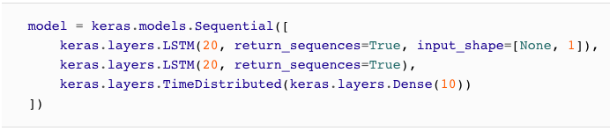
LSTM
.
If you consider the LSTM cell as a black box, it can be used very much like a basic cell, except it will perform much better; training will converge faster and it will detect long-term dependencies in the data.
The units of an LSTM are used as building units for the layers of a RNN, which is then often called an LSTM network.
LSTM’s contain their information in a memory, that is much like the memory of a computer because the LSTM can read, write and delete information from its memory.
eNAS

Slide 15
Again
And that is essentially what an LSTM or GRU does. It can learn to keep only relevant information to make predictions, and forget non relevant data.
In this case, the words you remembered made you judge that it was good.
eNAS

Slide 16
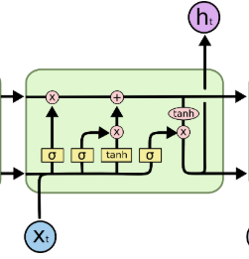
Basic LSTM Cell
Memory Cell
C_{t-1}
C_{t}
h_{t-1}
h_{t}
Forget Gate
Output Gate
Input Gate
eNAS

Slide 17
LSTM CELL
As the long-term state c(t–1) traverses the network from left to right, you can see that it first goes through a forget gate, dropping some memories, and then it adds some new memories via the addition operation (which adds the memories that were selected by an input gate).
The result c(t) is sent straight out, without any further transformation.
So, at each time step, some memories are dropped and some memories are added.
Moreover, after the addition operation, the long-term state is copied and passed through the tanh function, and then the result is filtered by the output gate. This produces the short-term state h(t) (which is equal to the cell’s output for this time step y(t)).
eNAS

Slide 18
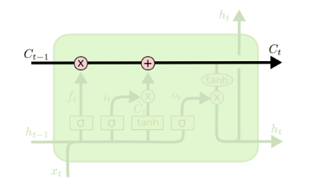
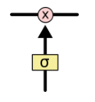
LSTM CELL
The key to LSTMs is the cell state, the horizontal line running through the top of the diagram.
The cell state is kind of like a conveyor belt. It runs straight down the entire chain, with only some minor linear interactions.
The LSTM does have the ability to remove or add information to the cell state, carefully regulated by structures called gates.
As the cell state goes on its journey, information gets added or removed to the cell state via gates
Gates are a way to optionally let information through. They are composed out of a sigmoid neural net layer and a pointwise multiplication operation.
eNAS

Slide 19
Gates are a way to optionally let information through. They are composed out of a sigmoid neural net layer and a pointwise multiplication operation.
The sigmoid layer outputs numbers between zero and one, describing how much of each component should be let through. A value of zero means “let nothing through,” while a value of one means “let everything through!”.
In an LSTM you have three gates: input, forget and output gate. These gates determine whether or not to let new input in (input gate), delete the information because it isn’t important (forget gate) or to let it impact the output at the current time step (output gate). You can see an illustration of a RNN with its three gates above.
eNAS

Slide 20
Step-by-Step LSTM Walk Through
This incredible blog post
Marwa

Slide 21
GATES
Now let’s look at where new memories come from and how the gates work.
The current input vector x(t) and the previous short-term state h(t–1) are fed to four different fully connected layers.

Slide 22
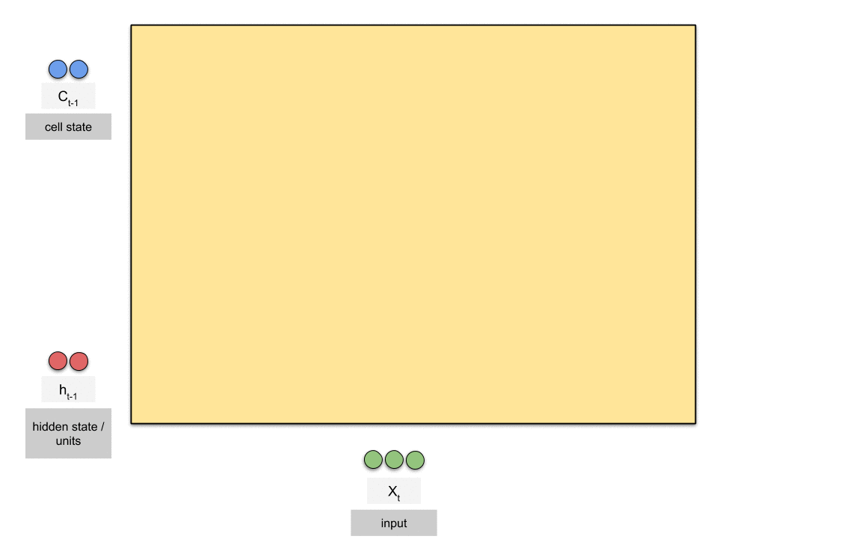
GATES
Marwa
Notes:
https://towardsdatascience.com/animated-rnn-lstm-and-gru-ef124d06cf45

Slide 23
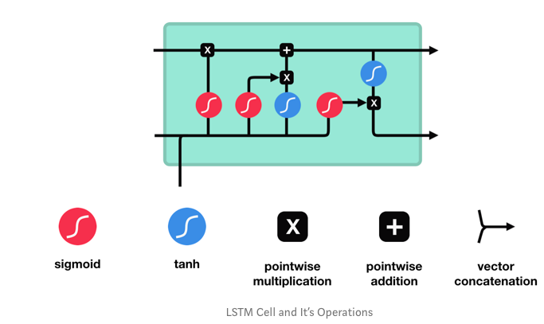
GATES
Marwa
Gates contains sigmoid activations.
A sigmoid activation is similar to the tanh activation.
Instead of squishing values between -1 and 1, it squishes values between 0 and 1.
That is helpful to update or forget data because any number getting multiplied by 0 is 0, causing values to disappears or be “forgotten.”
C_{T-1}
OUTPUT
h_{T-1}

Slide 24
Forget GATE
The first step in our LSTM is to decide what information we’re going to throw away from the cell state.
This decision is made by a sigmoid layer called the “forget gate layer.”
It looks at h t−1 and xt, and outputs a number between 0 and 1 for each number in the cell state C t−1.
Let’s go back to our example of a language model trying to predict the next word based on all the previous ones. In such a problem, the cell state might include the gender of the present subject, so that the correct pronouns can be used. When we see a new subject, we want to forget the gender of the old subject.
Marwa

Slide 25
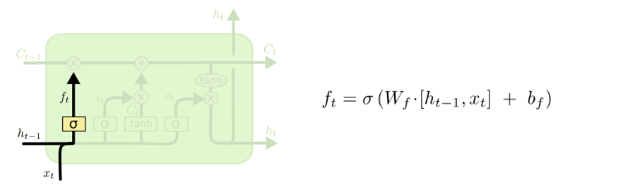
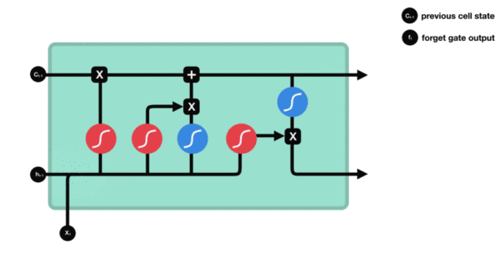
Forget GATE
Forget gate
This gate decides what information should be thrown away or kept.
Information from the previous hidden state and information from the current input is passed through the sigmoid function.
Values come out between 0 and 1. The closer to 0 means to forget, and the closer to 1 means to keep.

Slide 26
Input GATE
The next step is to decide what new information we’re going to store in the cell state.
This has two parts
a sigmoid layer called the “input gate layer” decides which values we’ll update.
a tanh layer creates a vector of new candidate values, C~t, that could be added to the state.
In the next step, we’ll combine these two to create an update to the state.
Marwa

Slide 27
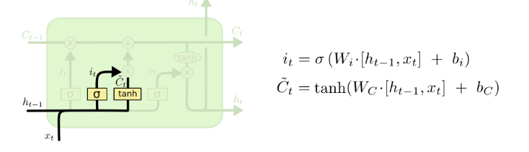
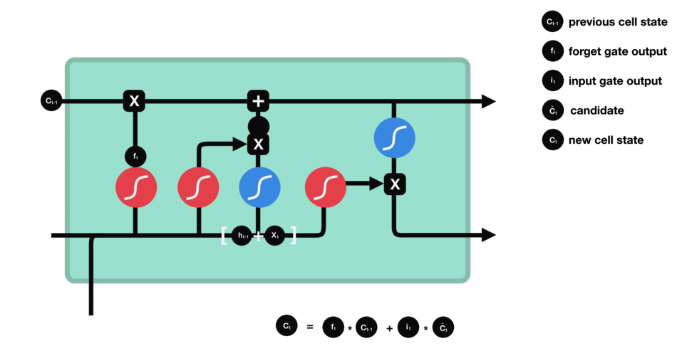
Input GATE
Input Gate
First, we pass the previous hidden state and current input into a sigmoid function. That decides which values will be updated by transforming the values to be between 0 and 1. You also pass the hidden state and current input into the tanh function to squish values between -1 and 1 to help regulate the network. Then you multiply the tanh output with the sigmoid output. The sigmoid output will decide which information is important to keep from the tanh output.
Marwa

Slide 28
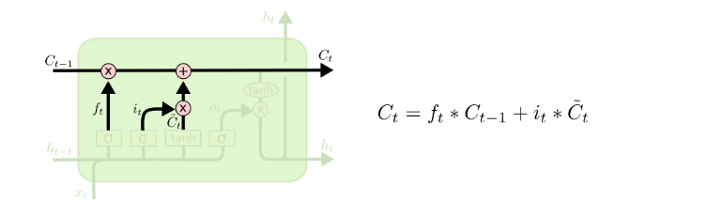
Input GATE
It’s now time to update the old cell state, Ct−1, into the new cell state Ct. The previous steps already decided what to do, we just need to actually do it.
We multiply the old state by ft, forgetting the things we decided to forget earlier. Then we add it∗C~t. This is the new candidate values, scaled by how much we decided to update each state value.
In the case of the language model, this is where we’d actually drop the information about the old subject’s gender and add the new information, as we decided in the previous steps.
Marwa

Slide 29
Output GATE
Finally, we need to decide what we’re going to output.
This output will be based on our cell state, but will be a filtered version.
First, we run a sigmoid layer which decides what parts of the cell state we’re going to output.
Then, we put the cell state through tanh (to push the values to be between −1 and 1) and multiply it by the output of the sigmoid gate, so that we only output the parts we decided to
For the language model example, since it just saw a subject, it might want to output information relevant to a verb, in case that’s what is coming next.
Marwa

Slide 30
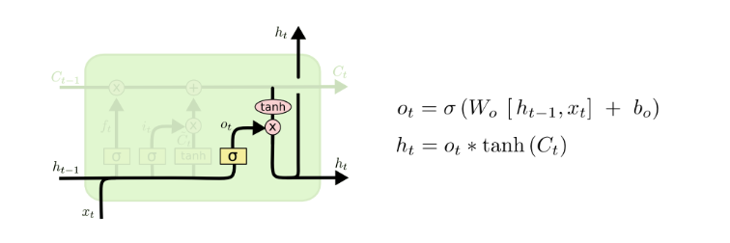

Output GATES
Output Gate
The output gate decides what the next hidden state should be. The hidden state is also used for predictions. First, we pass the previous hidden state and the current input into a sigmoid function. Then we pass the newly modified cell state to the tanh function. We multiply the tanh output with the sigmoid output to decide what information the hidden state should carry. The output is the hidden state. The new cell state and the new hidden is then carried over to the next time step.
eNAS

Slide 31
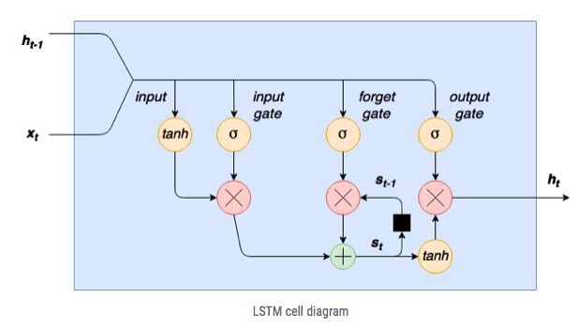
AGAIN
On the left hand side, we have our new word/sequence value xt being concatenated to the previous output from the cell ht−1. The first step for this combined input is for it to be squashed via a tanh layer.
The second step is that this input is passed through an input gate. An input gate is a layer of sigmoid activated nodes whose output is multiplied by the squashed input. These input gate sigmoids can act to “kill off” any elements of the input vector that aren’t required. A sigmoid function outputs values between 0 and 1, so the weights connecting the input to these nodes can be trained to output values close to zero to “switch off” certain input values (or, conversely, outputs close to 1 to “pass through” other values).
eNAS

Slide 32
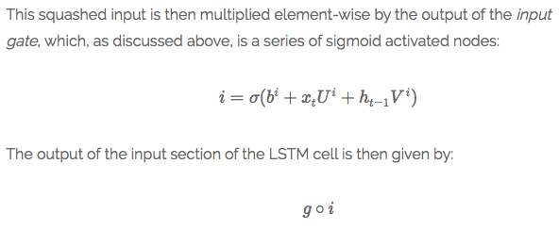
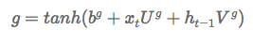
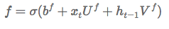
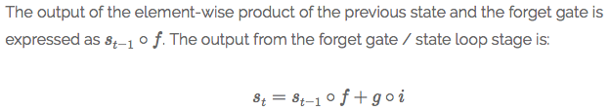
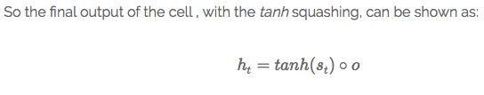
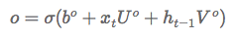
THE MATHEMATICS OF THE LSTM CELL:
Input
Forget
Output
eNAS

Slide 33
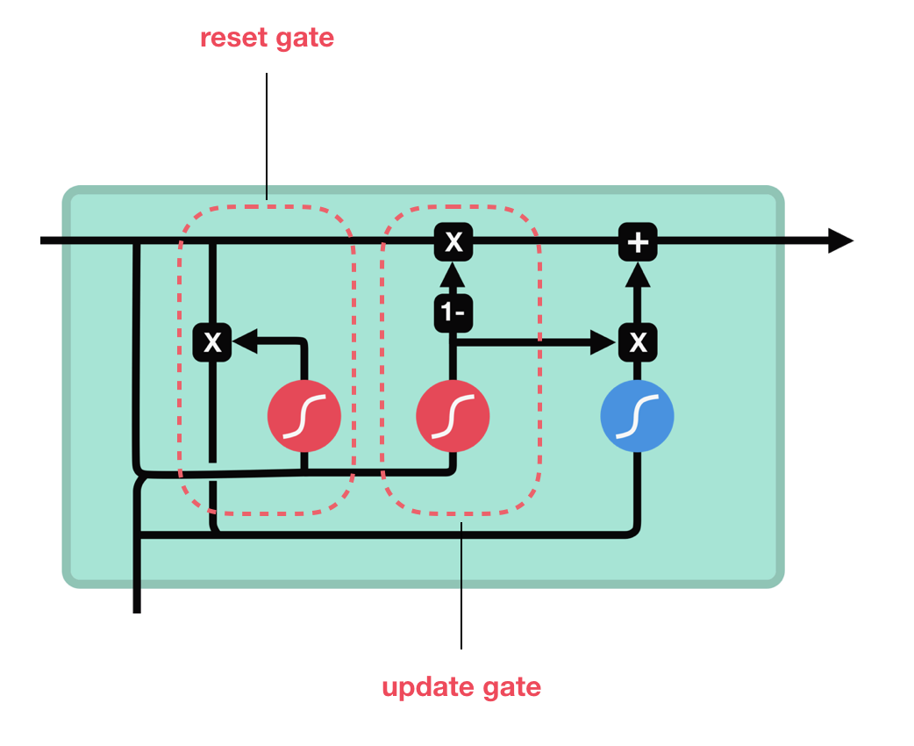
GRU
This comes to prevent the LSTM complications.
It has two gates only:
Reset gate: decide how much past information to forget.
Update gate: ٍSimilar to the forget and input gate.
GRU’s has fewer tensor operations; therefore, they are a little speedier to train then LSTM’s.
eNAS
Notes:
https://miro.medium.com/max/2084/1*jhi5uOm9PvZfmxvfaCektw.png

Slide 34
LSTM Tips and Tricks
How we can prevent the overfitting?
One way is by using:
Drop Out: is to ignore the randomly selected neurons (through the training).
Early Stopping: Force the model to stop learning, by knowing how many iterations can be run before the learner begins to over-fit (one kind of regularization).
How my output layer suppose to be?
That depends on your output shape, according to that you can adjust number of nodes needed.
eNAS

Slide 35
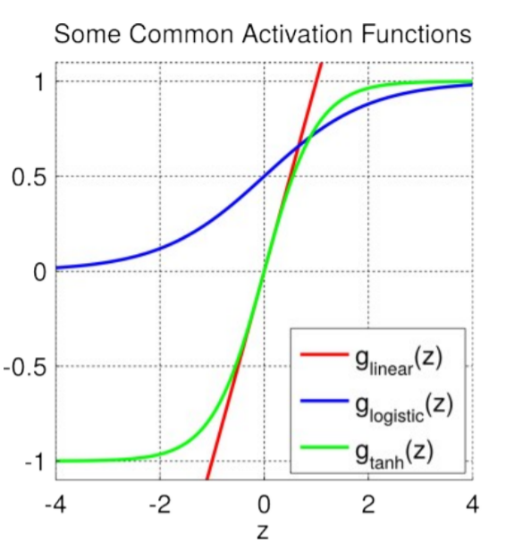
Mathematics
Which activation function to use depends on the application.
Whether the class is binary or multi.
It is your decision to choose.
eNAS

Slide 36
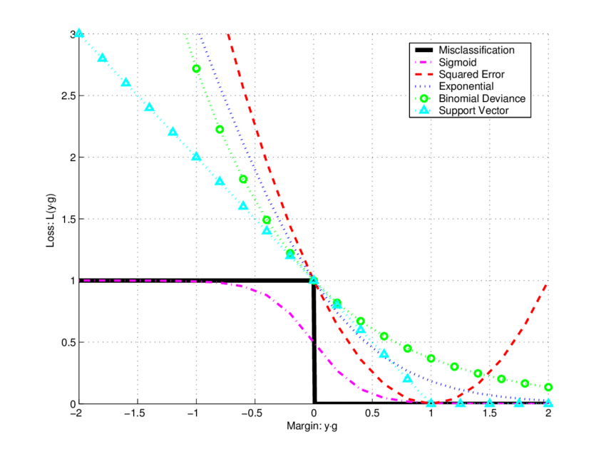
Loss Function
Is a function that maps an event or variables values onto a real number intuitively representing some "cost" associated with the event.
It gives us a measure how far from perfect is the performance of our network on a given dataset.
eNAS
Notes:
https://www.google.com/search?q=Loss+function&source=lmns&rlz=1C1JZAP_enJO866JO866&hl=en&ved=2ahUKEwjT2a29y_ToAhUK3RoKHR20A3QQ_AUoAHoECAEQAA

Slide 37

Shape of LF
Very nice shape of loss function.
eNAS
Notes:
https://www.google.com/search?q=Loss+function&source=lmns&rlz=1C1JZAP_enJO866JO866&hl=en&ved=2ahUKEwjT2a29y_ToAhUK3RoKHR20A3QQ_AUoAHoECAEQAA

Slide 38
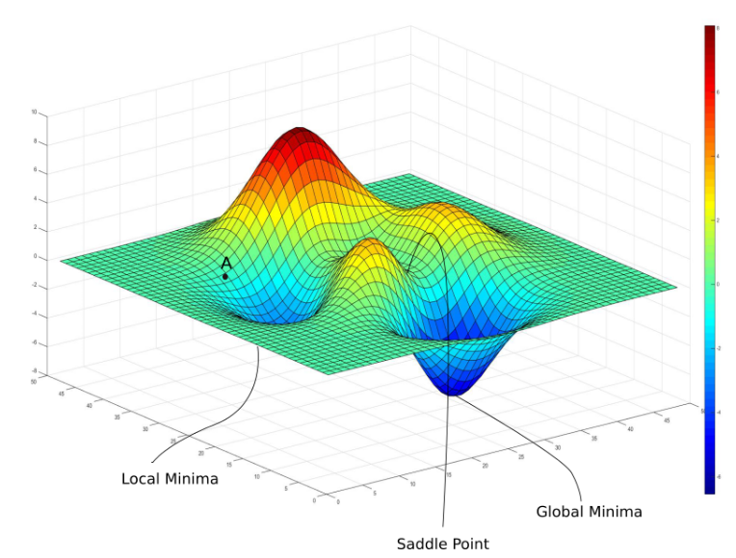
Mathematics
if you initialize your weights at point A, then you're gonna converge to the local minima, and there's no way gradient descent will get you out of there,
Gradient = 0
eNAS
Notes:
https://www.google.com/search?q=Loss+function&source=lmns&rlz=1C1JZAP_enJO866JO866&hl=en&ved=2ahUKEwjT2a29y_ToAhUK3RoKHR20A3QQ_AUoAHoECAEQAA

Slide 39
Mathematics
Loss Function
+
Activation Function
Are often chosen together, at some point you may choose the Softmax as an activation function and the Cross-Entropy as the loss function.
For a binary classification function.
eNAS
Notes:
https://www.google.com/search?q=Loss+function&source=lmns&rlz=1C1JZAP_enJO866JO866&hl=en&ved=2ahUKEwjT2a29y_ToAhUK3RoKHR20A3QQ_AUoAHoECAEQAA

Slide 40
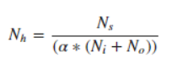
LSTM Tips and Tricks
We need to make some intuitions while building a model by choosing the right parameters:
Trial and Error
You can try many choices like different variations of the:
K-fold.
Cross Validation.
But how we can know the best number of neurons to start with:
this formula can save us:
# of sample in the training data
# of output neurons
Scaling factor (2-10)
# of input neurons
eNAS
Notes:
https://towardsdatascience.com/choosing-the-right-hyperparameters-for-a-simple-lstm-using-keras-f8e9ed76f046

Slide 41
Codes
Please join me to see how I used the LSTM during the last year Kaggle competition for the Question to Question similarity task:
Question To Question Similarity Work
ِMaybe we can play a little bit using LSTM:
Predicting Gender from the First Name
ِSequence Classification with LSTM Recurrent Neural Networks in Python with Keras
ِSequence Classification
Marwa & eNAS

Slide 42
Demos
Handwriting generation demo
Music composition

Slide 43
References
Understanding LSTM Networks
LSTM by Example using Tensorflow
https://machinelearningmastery.com/how-to-develop-lstm-modhttps://machinelearningmastery.com/how-to-develop-lstm-models-for-time-series-forecasting/els-for-time-series-forecasting/
Keras LSTM tutorial - How to easily build a powerful deep learning language model
https://www.tensorflow.org/guide/keras/rnn#cross-batch_statefulness
https://towardsdatascience.com/animated-rnn-lstm-and-gru-ef124d06cf45
https://hacks.mozilla.org/2018/09/speech-recognition-deepspeech/
https://danijar.com/tips-for-training-recurrent-neural-networks/

Slide 44
References
8. Text Prediction with TensorFlow and Long Short-Term Memory—in Six Steps
9. 人工智能python实现-理解LSTM层和GRU层
10. Understanding LSTM Networks
11. Jiasen, L. U., Caiming Xiong, and Richard Socher. "Sentinel gate for modulating auxiliary information in a long short-term memory (LSTM) neural network." U.S. Patent No. 10,565,306. 18 Feb. 2020.
12. Deng, Jun, et al. "Exploiting time-frequency patterns with LSTM-RNNs for low-bitrate audio restoration." Neural Computing and Applications 32.4 (2020): 1095-1107.

Slide 45
References
13. Loss Function
14. Predicting Gender from the First Name with an LSTM using Keras
15. https://blog.paperspace.com/intro-to-optimization-in-deep-learning-gradient-descent/
16. https://www.cs.umd.edu/~tomg/projects/landscapes/
17.http://pages.cs.wisc.edu/~shavlik/cs638/lectureNotes/Long%20Short-Term%20Memory%20Networks.p
18.https://colah.github.io/posts/2015-08-Understanding-LSTMs/?fbclid=IwAR3UCpsfZMFqitnKnFCf-NvaD2JuNFblat1nc-7IT5Bx-MHMKcl1DbA7q1k#fn1
19.https://machinelearningmastery.com/sequence-classification-lstm-recurrent-neural-networks-python-keras/

Slide 46

eNAS and Marwa

